Slide 1
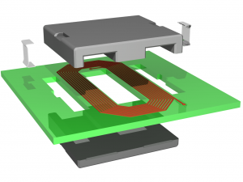
Design of a filter inductor with planar magnetics technology
Furkan Tokgöz

Slide 2
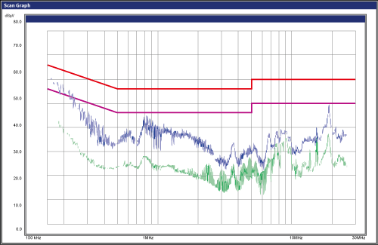
CM and DM noise
Trend towards to higher power density in electrical equipments, caused to usage of higher switching. In some applications, higher switching inject a noise in higher harmonics because of the parasitic capacitances and inductances. Since they can radiate to the environment, these noises can be dangerous to both human life and to electrical equipments.

Slide 3
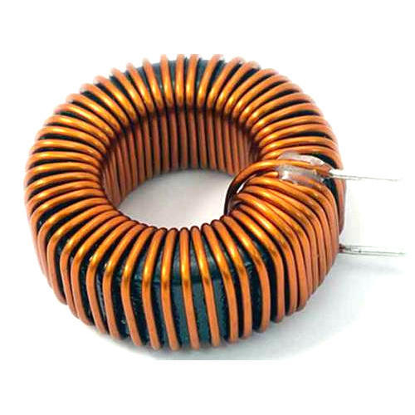
Conventional Inductor
In order to mitigate these noises, a filter is needed. Commonly, the filter used in this application is basically a LC filter. A conventional inductor is produced by winding a cable around a ferrite core which can be big and inefficient compared to the rest of the circuit.
Figure OR Image

Slide 4
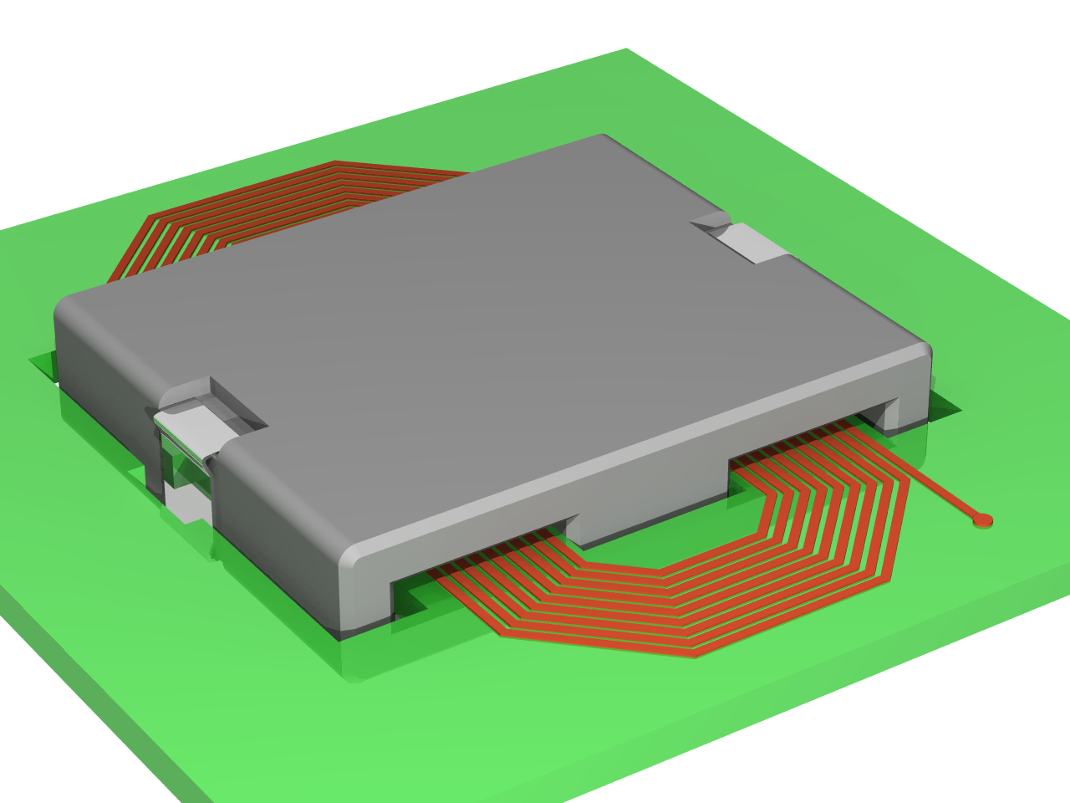
Planar Inductor
Windings of the planar inductor is printed on Printed Circuit Board (PCB). Thus, one can easily produce inductors in mass. Also, the height of the component is reduced significantly whereas its footprint increases. Since its area increases, it has better thermal characteristics compared to conventional inductors.

